Slide 1



Project BDO – WU Wien
Network Analysis for detecting shared risk factors between companies
Manuel Petschinger, Jakob Koller, Markus Weiss, Simon Böck

Slide 2
Project Overview
Data, Data Processing and NLP
Network Analysis
Link Prediction

Slide 3
Project Overview
BDO: The Company
Global network of public accounting firms, fifth largest worldwide.
Operates in 167 countries with over 88,000 employees.
Provides audit, tax, and advisory services.
Founded in 1963, originally "Binder Dijker Otte & Co."
Growth through significant mergers and acquisitions.
Related Fields: Data Science, Corporate Finance, and Risk Management
Integration of data science and analytics, corporate finance, and risk management in business.
Data Science & Analytics
Utilizes statistical techniques, machine learning, big data.
Aids in predicting market trends, risk assessment, informed financial decisions.
Corporate Finance
Focuses on financial activities of corporations.
Includes capital structure, funding strategies, investment decisions.
Key in maximizing shareholder value through strategic financial planning.
Risk Management
Identifies, assesses, and prioritizes risks.
Coordinates resources to minimize and control impact of risks.
Encompasses market, credit, and operational risks in finance sector.

Slide 4
Project Scope
Objective:
Conduct in-depth network analysis using provided data.
Derive, visualize, and explain relations between companies and entities in the network.
Predict future developments based on observable trends.
Data Set:
Public companies and other entities as network nodes.
Attributes include financial data, company metadata, etc.
Network Analysis:
Understand interrelations and dynamics as a graph or network.
Evaluate importance of entities based on connections and properties.
Comparative Analysis:
Compare clusters based on financial performance, ESG scores, etc.
Identify key players impacting company success.
Predictive Modelling:
Predict future financial performance and potential company connections.
Forecast industry integrations and shifts in company alignments.

Slide 5






Project Goals
Network Visualization and Understanding
Map out company-entity interconnections.
Spotlight central players and future links.
Predictive Analysis Focus
Predict future company connections.
Anticipate emerging risk factors.
Stakeholder Collaboration
Align with BDO coaches for expert guidance.
Update Dr. Hochreiter regularly on progress.
Feedback and Iteration
Refine work based on stakeholder feedback.
Aim for precision in final deliverables.
Final Presentation and Report
Consolidate analyses into a final report.
Present findings to BDO and stakeholders.
Success Criteria
Visualize network and key players
Predict future risk and connections
Fulfill BDO’s project criteria

Slide 6
Project Overview
Data, Data Processing and NLP
Network Analysis
Link Prediction

Slide 7
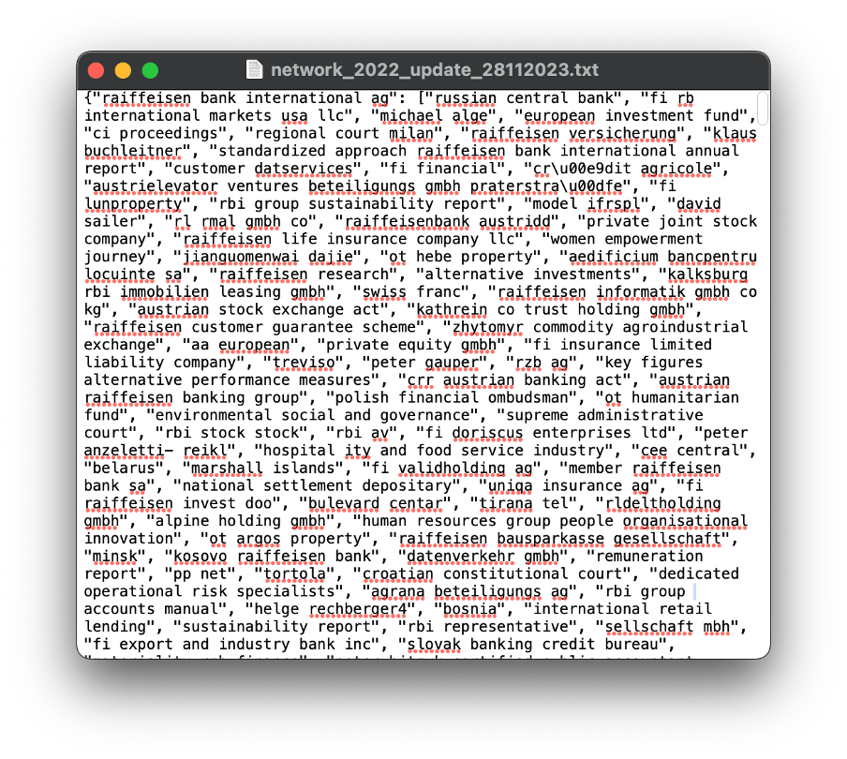
Data
4 JSON Files:
Companies and their interactions with various entities (other companies, locations, persons, …).
From Annual Reports.
Data for years 2011, 2013, 2016, 2022.
4 Excel Sheets with financial data:
Total Revenue, Cost of Revenue, Net Income, Net Debt, Total Assets, Total Liabilities, …
Data for years 2011, 2013, 2016, 2022.
1 Excel Sheet with labeled data:
Public data on Stock 600 companies.
Attributes: Name, ISIN, Location, Primary Industry, Exchange, Employee Count, CEO, CFO, Rating, Suppliers, Customers, Board Members.
Data for year 2023
Notes:
4 JSON files; companies featured in Euro Stoxx 600; interactions with various entities: companies, locations, and individuals; represent 2011, 2013, 2016, and 2022; serve as a foundation for constructing networks
need more financial data; BDO four additional datasets; financial data for companies in JSON files; 23 specific financial metrics for each company; example: Total Revenue, Net Income, Net Debt, etc.
Most recent dataset October 2023; labeled information about the Stoxx 600 companies; attributes: Name, ISIN, Location, Primary Industry, Exchange, …
Had to face a difficult challenge: unlabeled data

Slide 8
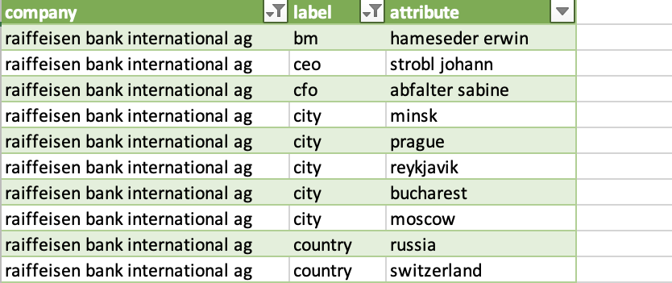
Data Processing and NLP
Assigning the attributes to categories:
English TRF model from Spacy:
- Named Entity Recognition (NER)
- ORG, PERSON, GPE, PRODUCT, …
Country-Converter (COCO):
- Standardizing country names
- Handle ambiguous country names
Lists of first and last names from data.europa.eu:
- Combination of first and last name
- Improve the labelling of persons
List of cities:
- Improve the labelling of cities
Company endings:
- gmbh, ag, group, ltd, sa, limited
- Improve the labelling of organisations
Other data processing tasks:
Merge the 2023 CIQ data to the network files:
- home_country
- home_city
- industry
- exchange
Merge the financial data to the network files
Notes:
Spacy; advanced tool for NLP tasks; ready-to-use features both fast and precise.
English TRF model, ability to recognize and categorize specific terms and names in text -> Named Entity Recognition (NER).
Additional methods
Country-Converter, Python package for converting and matching country-names between different classification schemes and standards; Example USA
first and last names EU-datasets
dataset that contains city-names
labeling organisations -> company endings
Many other prepro tasks ties

Slide 9
Project Overview
Data, Data Processing and NLP
Network Analysis - Companies as Nodes
Link Prediction

Slide 10




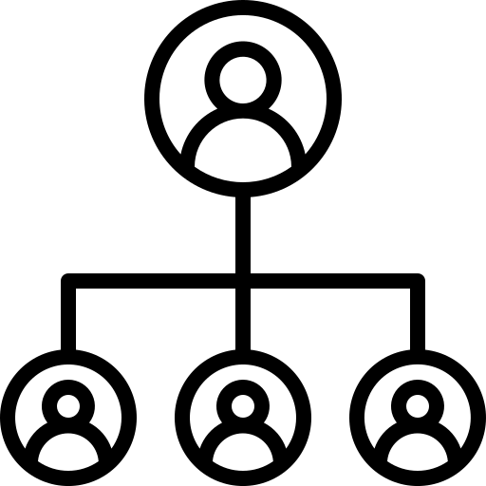

Basics about Networks
Nodes in our network:
Node
Edges in our network (classified from the NLP):
Edge
Notes:
Before we dive into our visualisations we need to clear up some definictions and basics about networks first.
When looking at such an example network as displayed here we see a few round dots and lines which connect these. The dots are so called nodes, and the lines are pronounced Edges.
In our case nodes would be represented as either companies, industries or countries. For the industries and countries as nodes network we had the Ciq Excel sheet from where we could merch both the industry aswell as the headquarter country to our companies.
An edge in such networks signals some sort of connection between the connected nodes. In our case that would be the different attributes, which we now have labeled, due to the preprocessing manuel explained a second ago.
The most important subclasses of our Edges would be the labels Person, Organisation, Country and Cities. With that knowledge we can now move on to the more complex part about our visualisations.

Slide 11
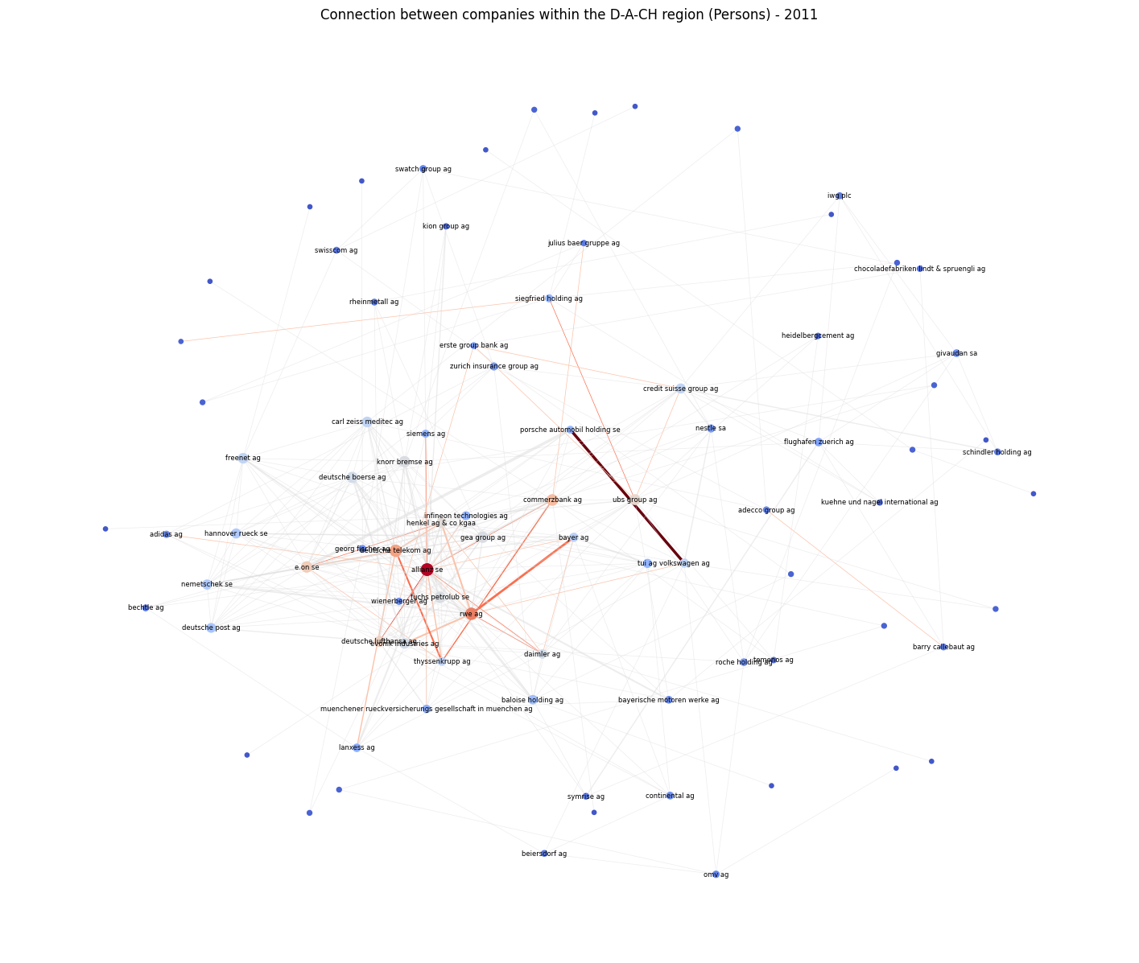

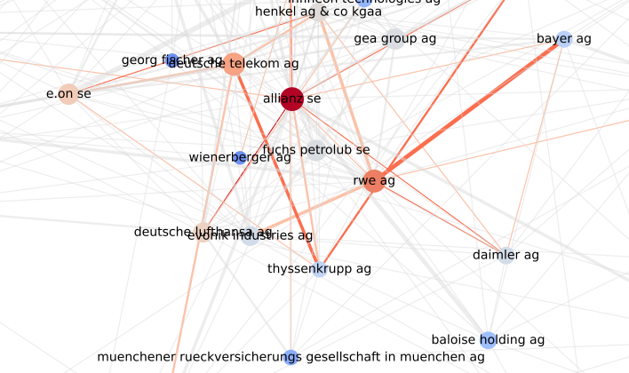
Basics about Networks
„coolwarm“ for the nodes:
„reds“ for the edges:
12
Notes:
Here we have a subnetwork of the year 2011, which only takes the label persons into account as connections. Meaning that all edges you can see here are based on a person, which interacts with both companies.
Another important part of our visualisations are the different node and edge colours. For our nodes we used the heatmap from the mathplot library, which makes it clear to immediatly differenciate between the most important and some less important nodes. Here it also takes into account on how central the nodes is in the network, meaning that the more connections to other nodes, the more likly it is to get plotted on the red side.
For our edges we choose the colour palette reds, which are just different tones of red. The reason we decided against the coolwarm colours for our edges is, that the weakest connections, aka blue edges would completly cover the hole network, whereas middlestrong connection which at the coolwarm map are white, would get lost and nearly invisible.
Furthermore we also set a threshold for our weight, a so called edge minimum, which would draw every connection under this point as grey, since again if we wouldnt do it like this would completly cover the interesting parts.

Slide 12
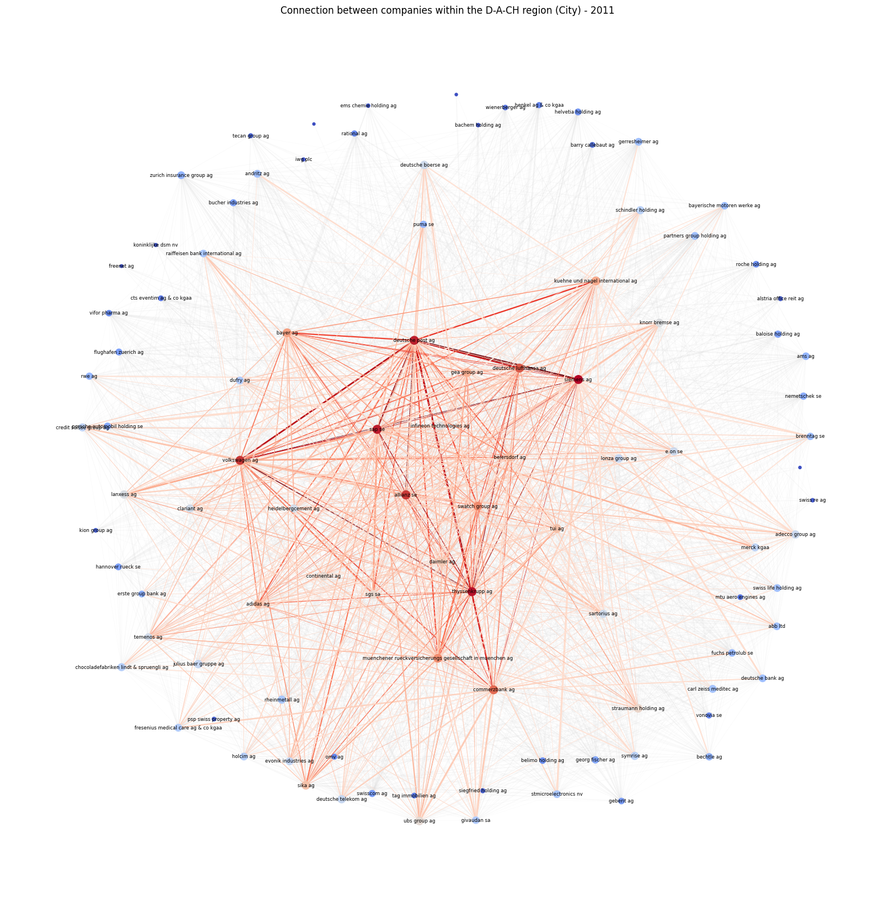
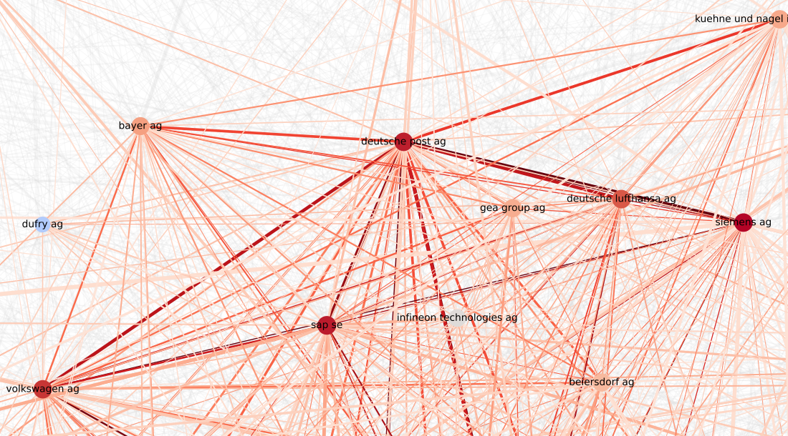
Network Visualization
Notes:
Due to the lack of time I can not go into detail about our findings, but here is just one example which we found was very interesting to share.
This network represents the dach regions companies and their connections based on the sublabel cities. When looking at the most important companies we notice the company Deutsch Post AG, delivery service. When seeing this network we can assume that in this network it is one of the keyplayers.

Slide 13
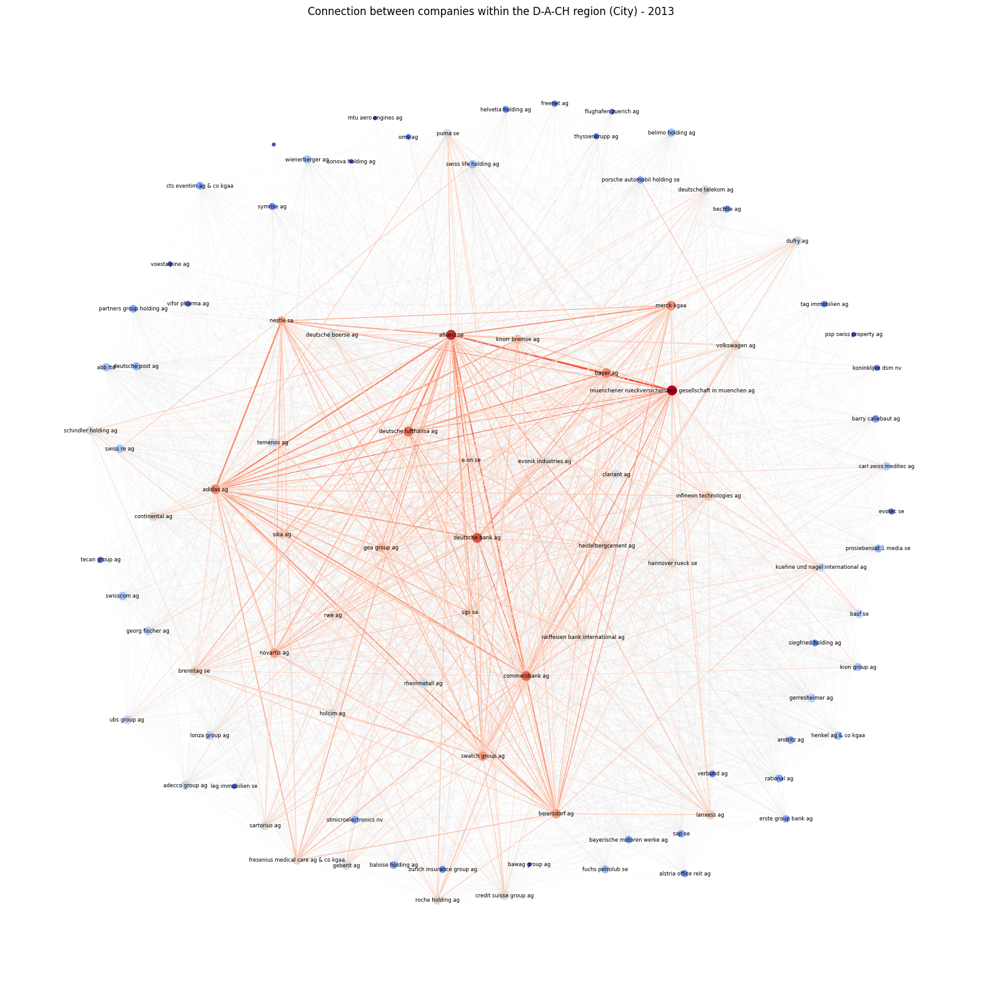
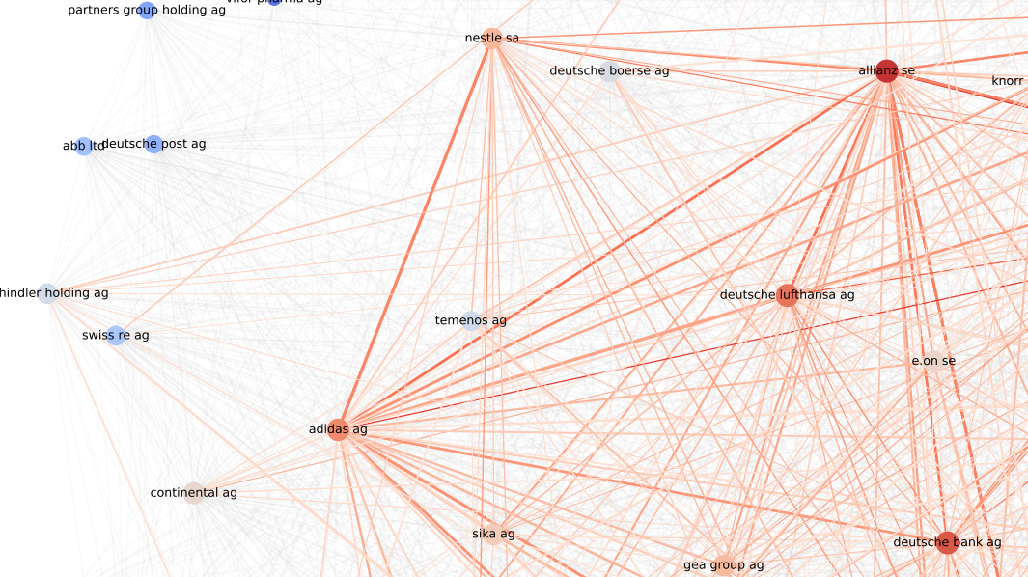
Network Visualization
Notes:
However if we start looking at where the company is over the next years, we clearly see a cut off point in relevance at the year 2013 and after that for 2016 and 2022 nothing really changes.

Slide 14
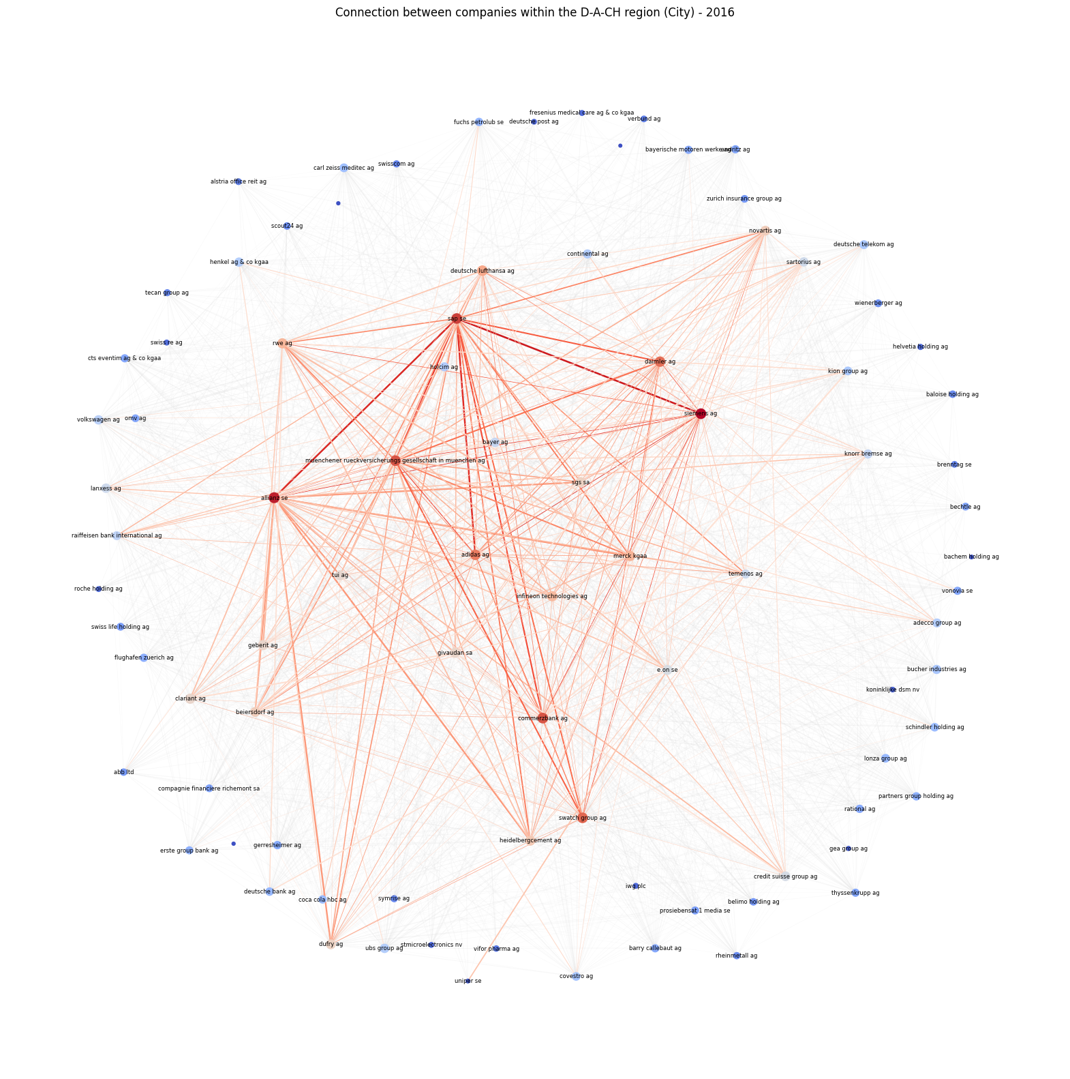
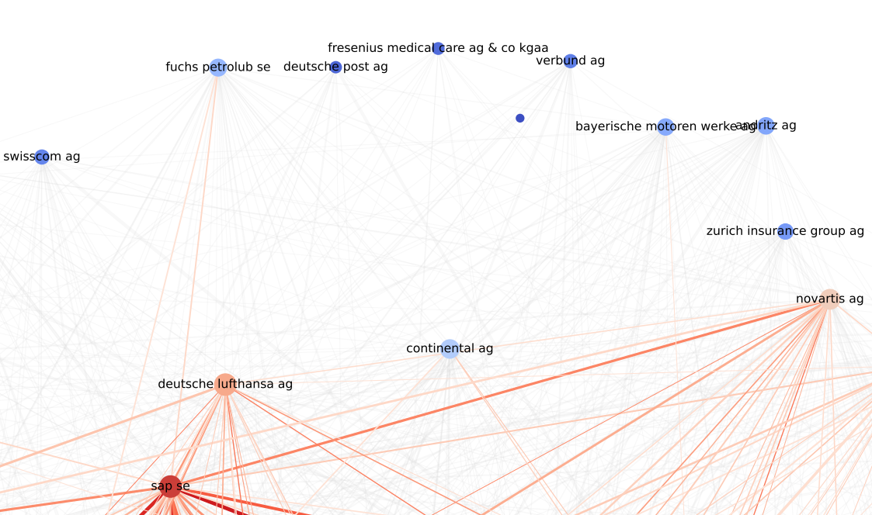
Network Visualization
Notes:
However if we start looking at where the company is over the next years, we clearly see a cut off point in relevance at the year 2013 and after that for 2016 and 2022 nothing really changes.

Slide 15
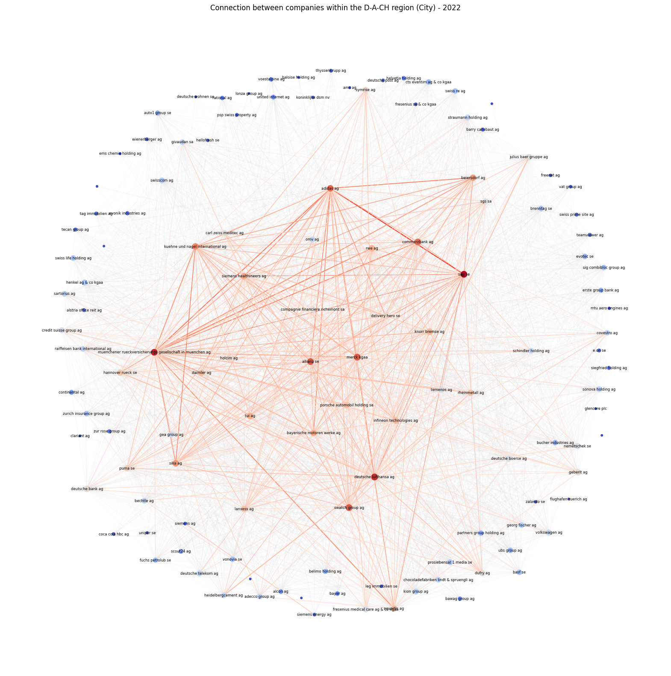
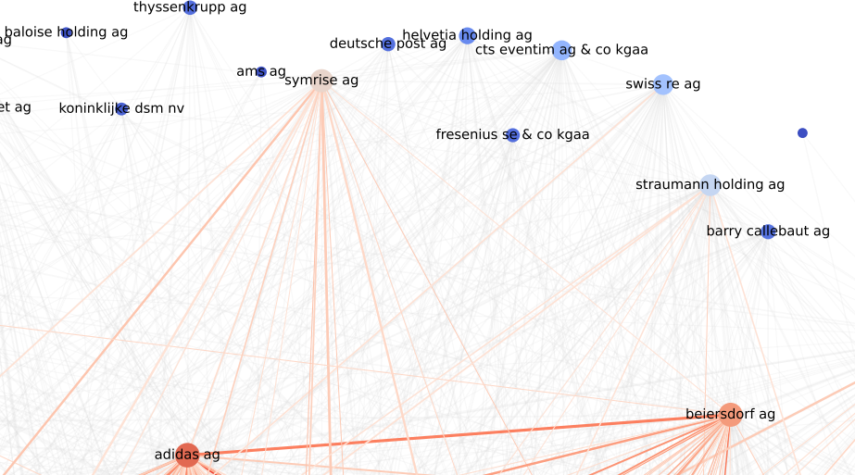
Network Visualization

Slide 16
Network Visualization
What happened to the former keyplayer „Deutsche Post AG“?
The „Postgesetz“ (engl. postal law) which was introduced in 1998.
Thought behind this was to set the base for competition amongst companies when it comes to delivery service.
By licence, the Deutsche Post AG had a limited exclusive right for the market in germany which extinguist in 2008.
The postal market was completely liberalized on January 1, 2013.
Notes:
So what happened to the company of industry?
We believe it has something to do with the Postgesetz „postal law“ and the concequences of the law which got introduced in 1998. Before that the company had a sort of monopol for the delivery market in germany.
The thought behind this law was to set a base of competition for differenct companies inside this industry.
The deutsche post further had a special licence which expired in 2008 and could not be extended, which gave the firm an exclusive right for the industry as a transitional phase.
After that, and with especially 2013, the hole post market in europe got completly liberalized and therefore companies like amazon or ups were real competition for the company.
We believe that this would be the reasons behind this drastic change in 2013.
That was is from my side and now manuel will take over for the countries as nodes visualisations.

Slide 17
Project Overview
Data, Data Processing and NLP
Network Analysis - Countries as Nodes
Link Prediction

Slide 18
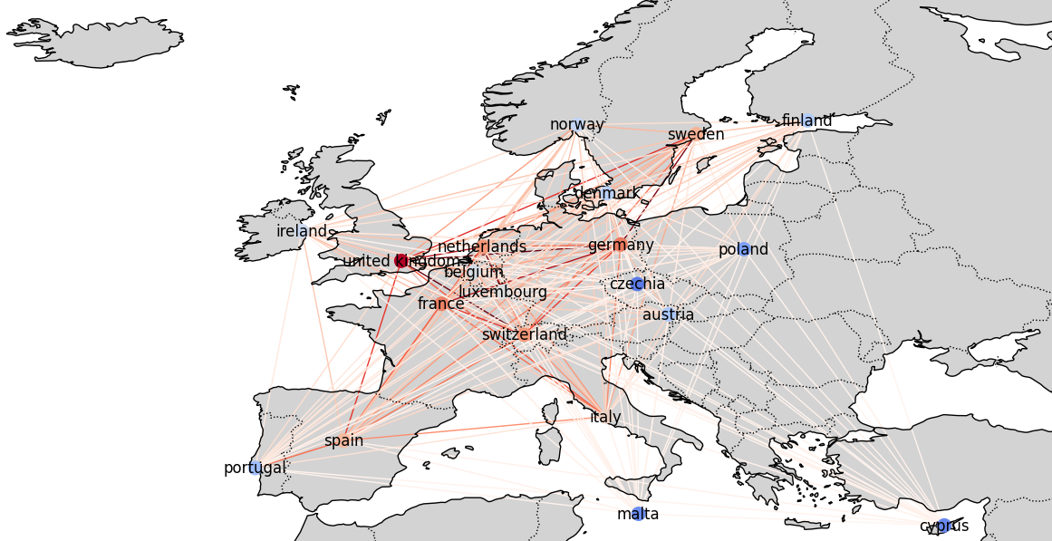
Countries as Nodes - 2022
Notes:
The UK's leading position might be due to its significant financial sector, especially London's role as a global financial hub. The UK has a diverse economy with strong sectors in finance, pharmaceuticals and energy.

Slide 19
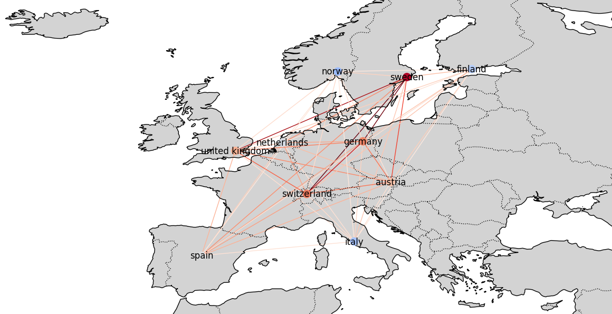
Industrial Machinery, Supplies, Components - 2011
Notes:
Austria might not be the largest economy, but it has a strong industrial base.

Slide 20
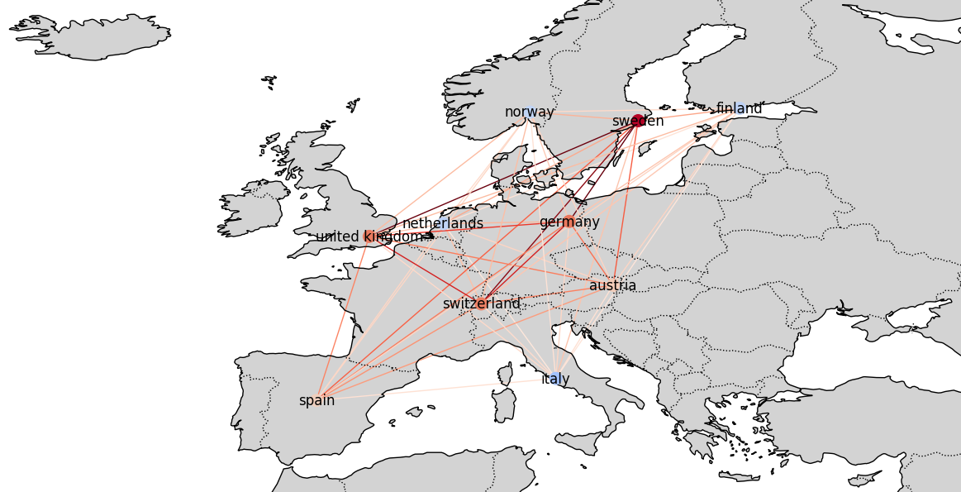
Industrial Machinery, Supplies, Components - 2013

Slide 21

Industrial Machinery, Supplies, Components - 2016

Slide 22

Industrial Machinery, Supplies, Components - 2022
Notes:
Network shifted more towards other countries like UK or Sweden as its home of world-leading companies like SKF and Sandvik.

Slide 23
Project Overview
Data, Data Processing and NLP
Network Analysis - Clustering
Link Prediction

Slide 24
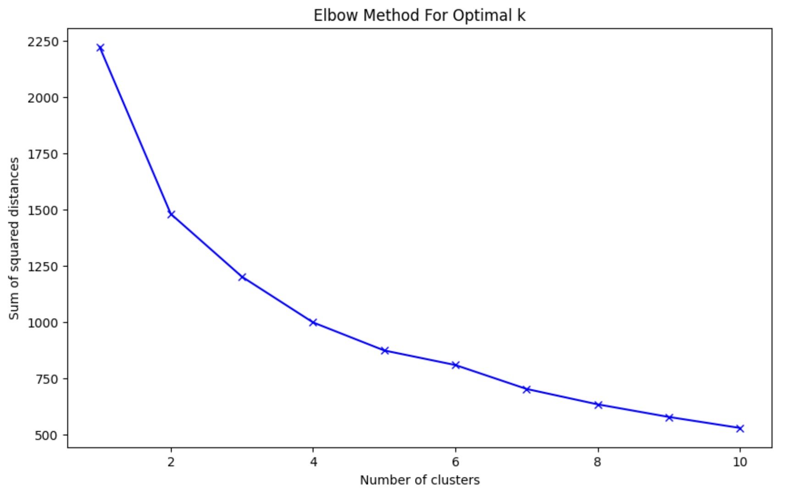
Introduction Clustering
Network details
ML – Kmeans Clustering
2011 network only since slight change
Network based on label “organization”
Nodes: 101 nodes (1 node is filtered out since not connected)
Edges: 5049
Average Degree: 99.99
Network Visualization:
Gephi
Ran network visualization algorithms – Fruchterman Reingold, Force Atlas 2, Force Atlas 2
Transform network graph back to a pandas dataframe
Peform ML – Kmeans on financial data (node attributes)
Merge back to network graph as attribute
Cut at 2 with elbow method – a reasonable cut. A cut at 3 would have clustered 2/3 companies in one cluster
Similar for all the networks regarding cut
Louvain Community Detection
Community Detection: The Louvain method is a community detection algorithm that identifies clusters in networks by optimizing modularity.
Modularity Optimization: It iteratively maximizes the modularity score, a measure of the density of links within communities versus between them.
Detected 3 clusters for 2011 network
Does not consider the attributes we assigned to the nodes (financial data, industries or geogprahy) but uses the edges that were constructed with the label “organizsation”.
Different algorithms exist, this one seemed to work best for our network

Slide 25
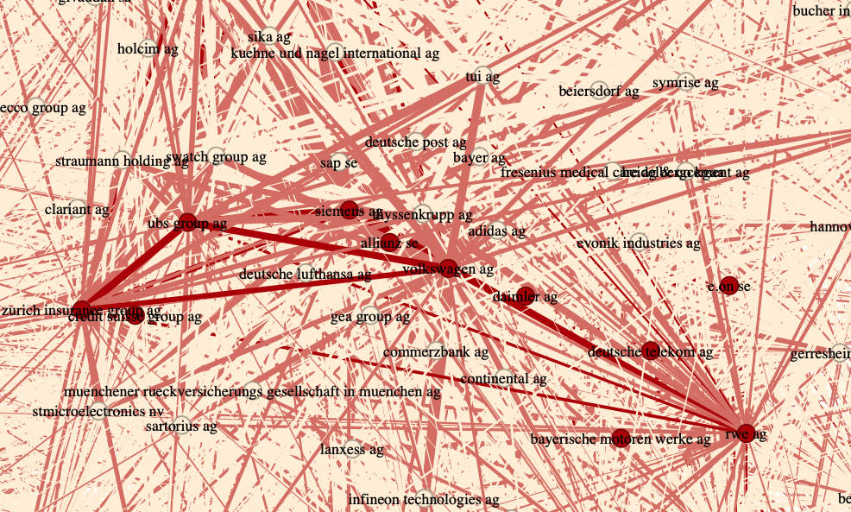
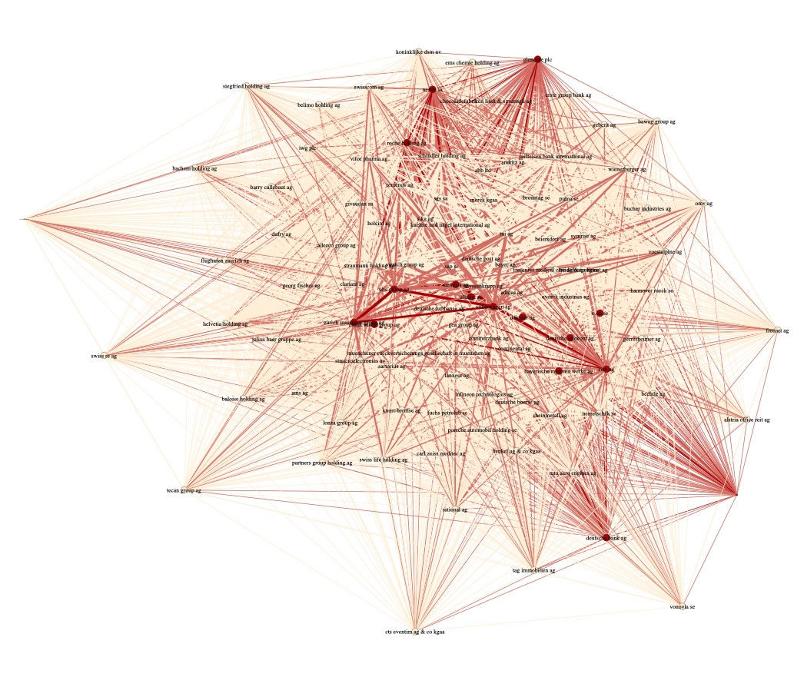
K-Means | Network Visualization
Network Cluster
Light Red edges visualize connections between both clusters
1. Cluster:
16 companies (red colored nodes)
Comapanies are quite large (assets, revenue, etc.)
2. Cluster:
85 companies (orange colored nodes)

Slide 26
K-Means | Cluster Comparison
Balance Sheet - Assets
KPIs - Ratios
Assets
Comparison:
Cluster 2 has significantly lower assets
Cluster 1 has a very low equity/asset ratio
Gross Margin
Liabilities
RoE
39%
Equity
RoA
29%
Cluster 1
Cluster 2
17%
14%
P&L – Revenue
4%
6%
Revenue
Comparison:
Both Cluster 1 and 2 seem to have similar relative performance measure but hugely differ in size
COGS
Cluster 1
Cluster 2
Gross Profit
Comparison:
Cluster 1 has a 10% lower gross margin. However, the ofter ratios (Return on Equity and Return on Assets) seem to differ only slightly.
The K-means seems to have clustered the companies based on size rather then profitability
Cluster 1
Cluster 2

Slide 27
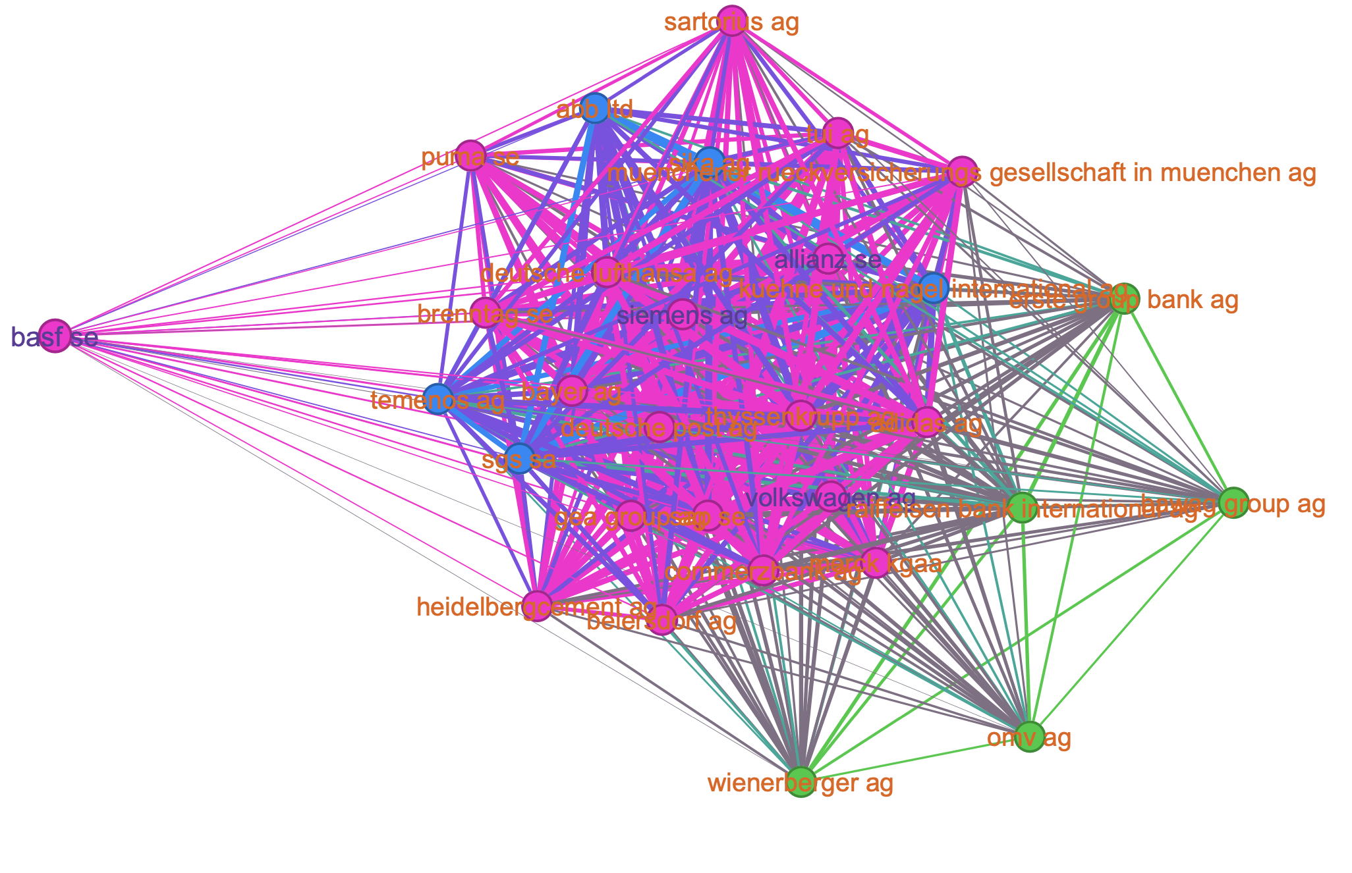
Louvain | Cluster 1
Louvain Community Detection
Colour of node represents the HQ country
Colour of edges represents connection to other HQ country – same colour is same HQ country, mixed colour is connection between nodes with different HQ
Majority of companies are headquartered in Germany (67%)
Nodes: 30
Edges: 435
Average Degree: 29
Top3 Industries: diversified banks (13.33%), construction materials (6.67%), application software (6.67%), pharmaceuticals (6.67%)
Switzerland
Austria
Germany

Slide 28
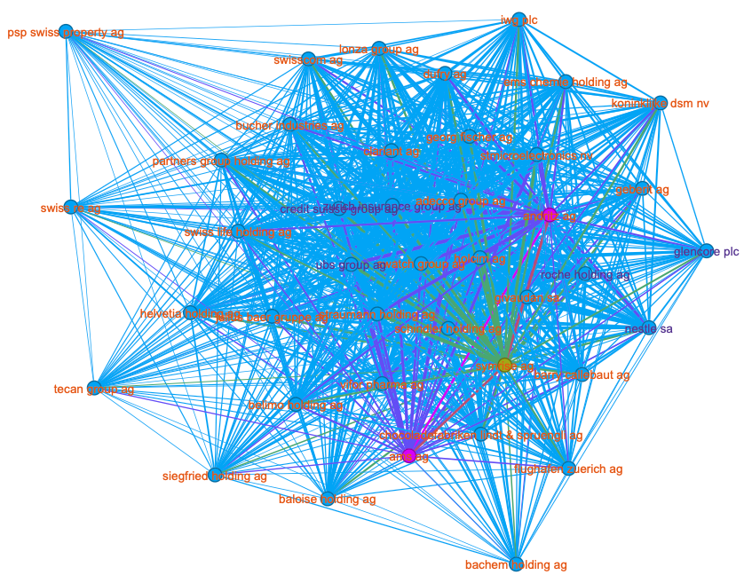
Louvain | Cluster 2
Louvain Community Detection
Colour of node represents the HQ country
Colour of edges represents connection to other HQ country – same colour is same HQ country, mixed colour is connection between nodes with different HQ
Majority of companies are headquartered in Switzerland (93%)
Nodes: 41
Edges: 820
Average Degree: 40
Top3 Industries: specialty chemicals (12.20%), life sciences tools and services(9.76%), multi_line insurance(7.32%), package foods and meats (7.32%), industrial machinery and supplies and components (7.32%)
Austria
Germany
2%
5%
Switzerland

Slide 29
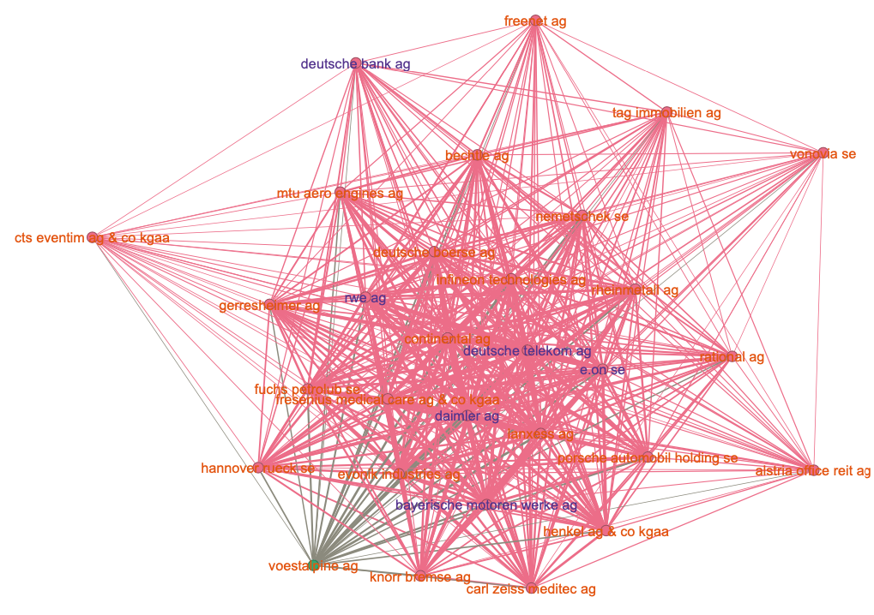
Louvain | Cluster 3
Louvain Community Detection
Colour of node represents the HQ country
Colour of edges represents connection to other HQ country – same colour is same HQ country, mixed colour is connection between nodes with different HQ
Majority of companies are headquartered in Germany (97%)
Nodes: 30
Edges: 435
Average Degree: 29
Top3 Industries: automobile manufacturers (10%), real estate operating companies (6.67%), aerospace and defense (6.67%)
Austria
3%
Germany

Slide 30
Project Overview
Data, Data Processing and NLP
Network Analysis
- Companies as Nodes
- Countries as Nodes
- Clustering
Link Prediction

Slide 31
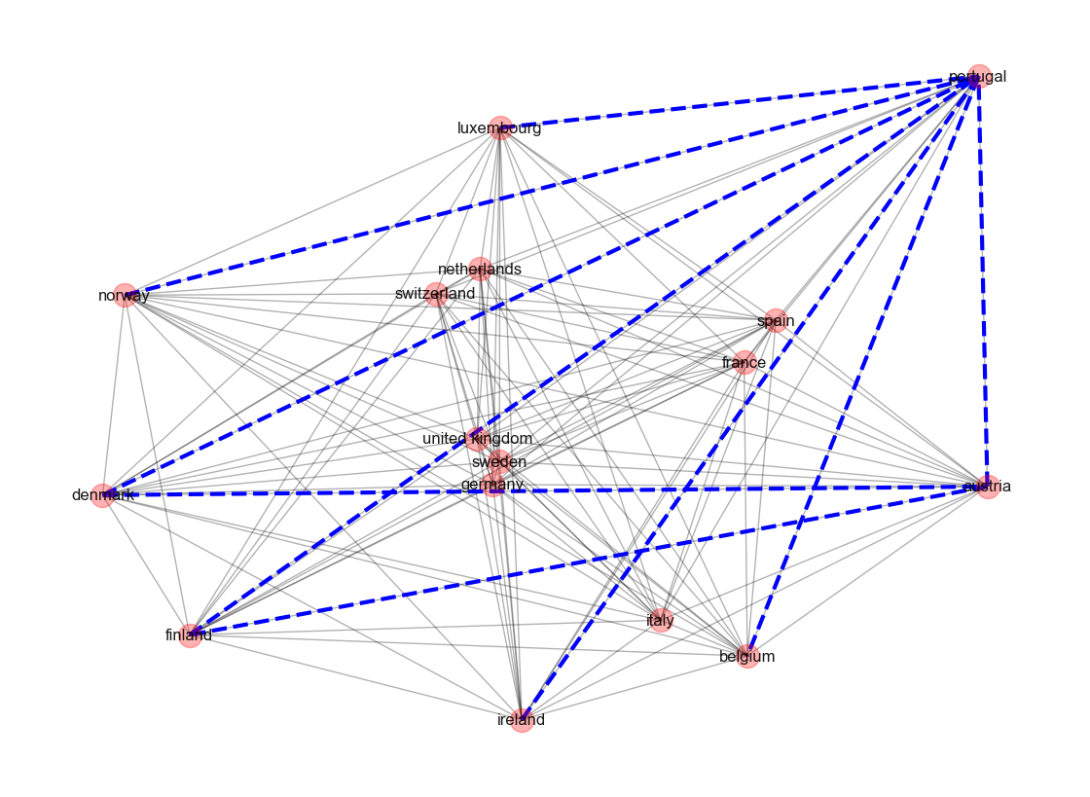
Link Prediction
Algorithms for link prediction
Prerequisites for the algorithms
Shared immediate enviroment:
Jaccard Coefficient:
Similarity between the sets of neighbors of two nodes.
Common Neighbor:
Similar to the Jaccard Coefficient
Counts number of common neighbors between two nodes.
Plus unique shared connections:
Adamic Adar Index:
Common neighbors but weighs less-connected neighbors more heavily.
Sharing a less-common neighbor > sharing a highly-connected one
Highly connected nodes:
Preferential Attachment:
More connections = greater likelihood for new connections
Plus distant/indirect connections:
Katz Score:
Considers also the paths of length up to X between nodes
Damping factor reduces influence of longer paths.
Graph-Structured Data
Existing Connections
NOT a fully-connected network
Appropriate Algorithm Selection
Results for filtered Country network

Slide 32
Thanks for your attention!
Please feel free to ask any questions.

Slide 33
Appendix

Slide 34
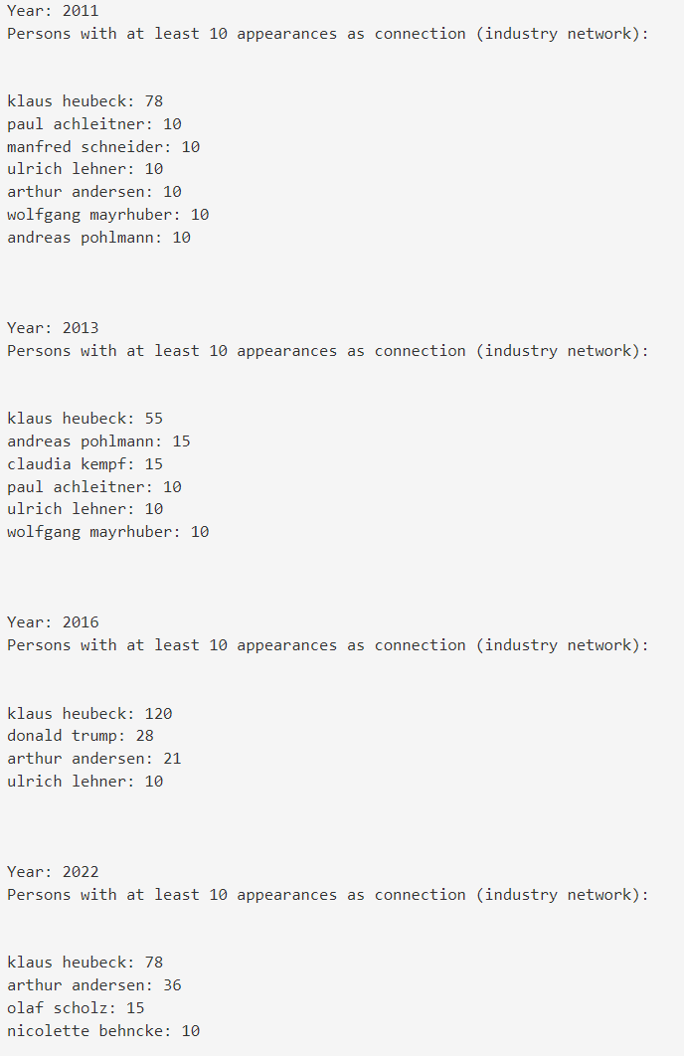
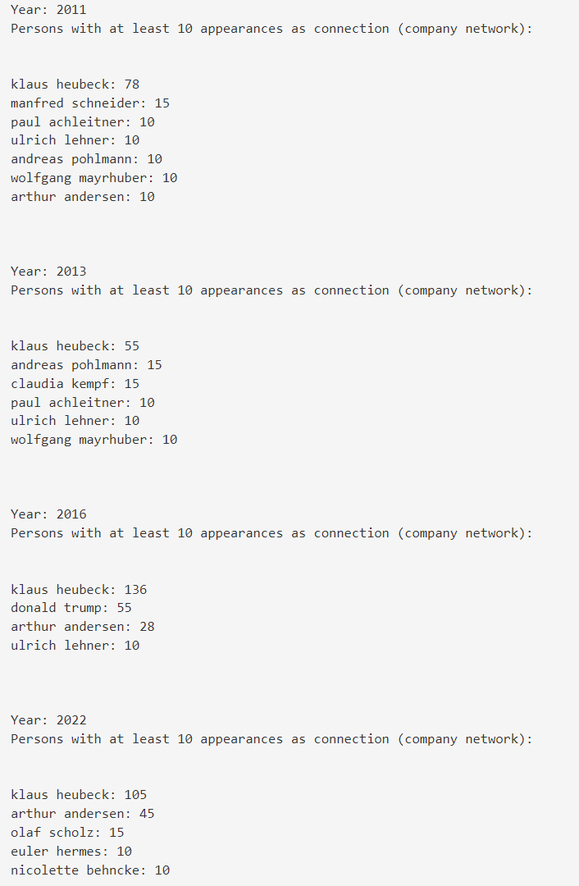
Appendix – Subnetwork Person

Slide 35
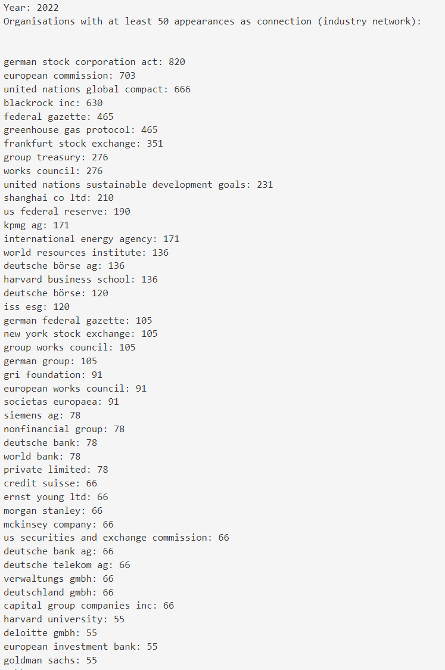
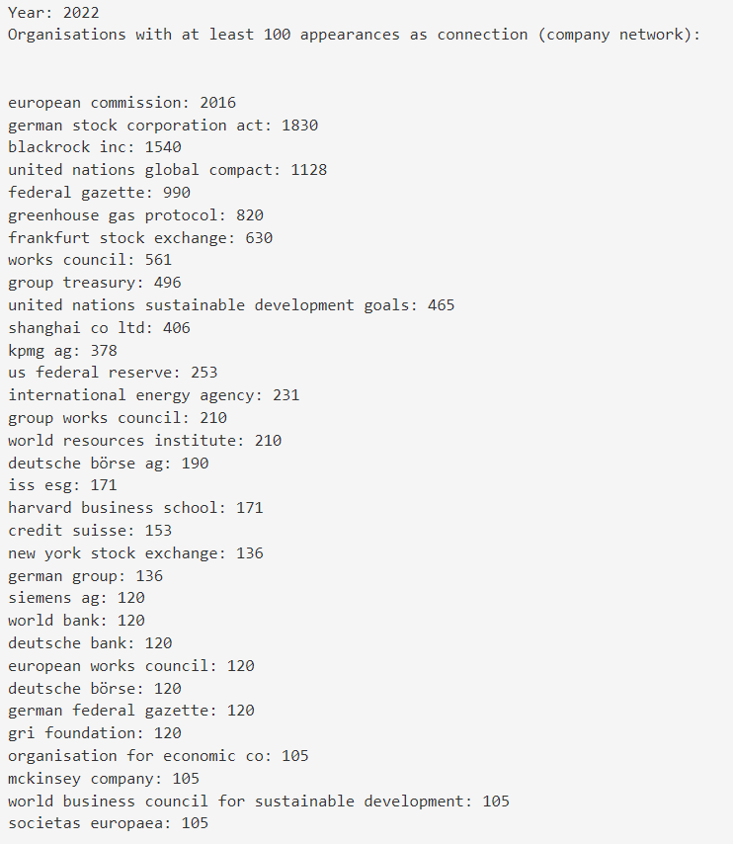
Appendix – Subnetwork Org

Slide 36
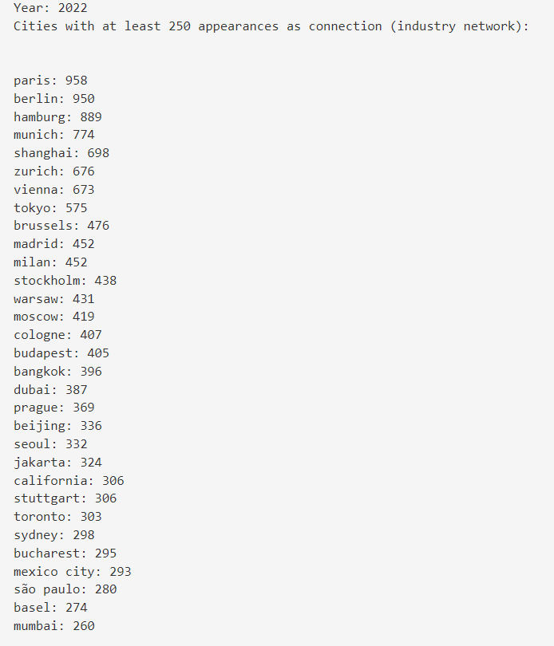
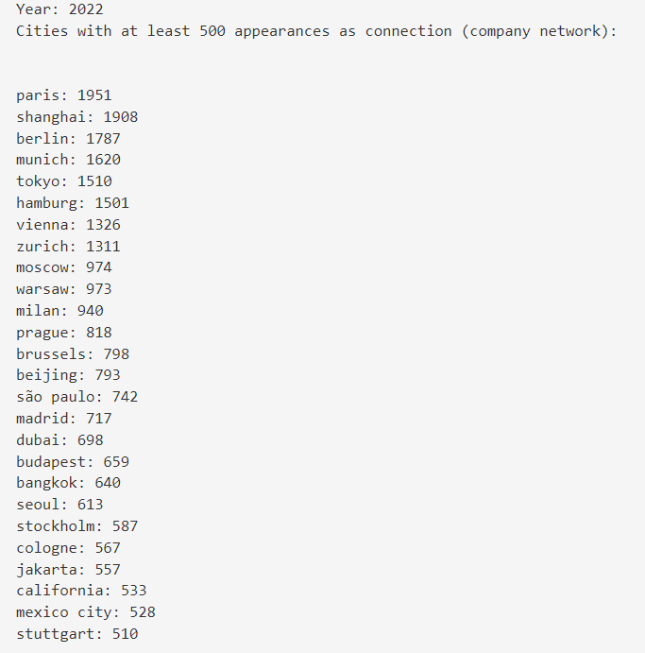
Appendix – Subnetwork City

Slide 37
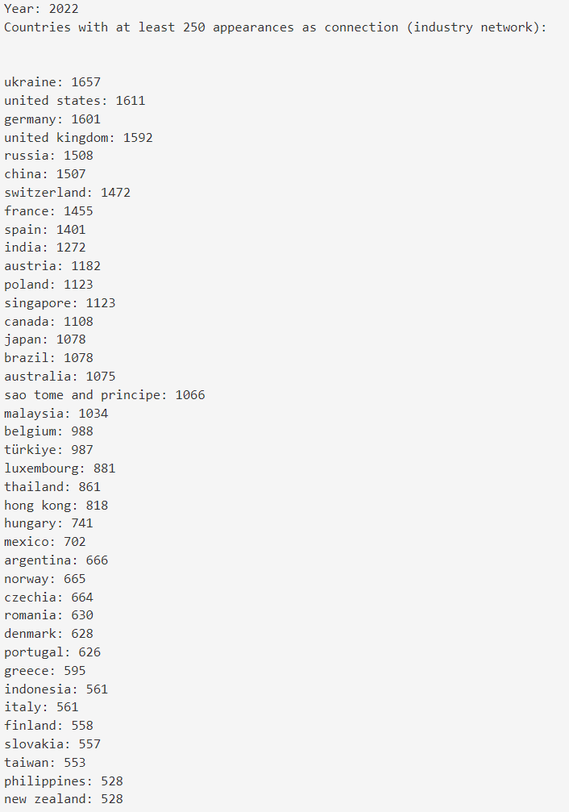
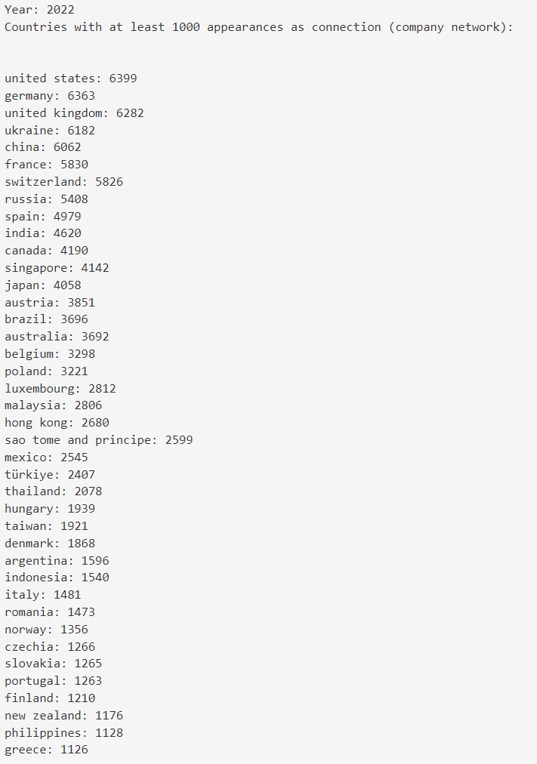
Appendix – Subnetwork Country

Slide 38
K-Means | Cluster Comparison
Balance Sheet - Assets
KPIs - Ratios
Assets
Gross Margin
39%
Liabilities
RoE
Equity
RoA
29%
Cluster 1
Cluster 2
P&L – Revenue
17%
Revenue
14%
COGS
Gross Profit
6%
4%
Cluster 1
Cluster 2
Cluster 1
Cluster 2

